Slide 1

Lexicons for Sentiment Effect and Connotation

Slide 2
Contents
Introduction
Sentiment Lexicons (SL)
Examples of SL
Connotation Lexcions (CL)
Examples of CL
Applications
Combine with Machine Learning

Slide 3
Introduction
Sentiment Effect and Connotation
  The sentiment effect refers to the emotional impact or tone that a word or phrase conveys beyond its literal meaning.
  It reflects the positive, negative, or neutral emotions associated with a word, which can influence how the word is perceived and how it contributes to the overall sentiment of a sentence or text.
  Connotation refers to the additional meanings, associations, or implications that a word carries beyond its explicit definition.
  Connotations can be positive, negative, or neutral and contribute to the nuanced interpretation of a word in context.

Slide 4
Introduction
Lexicons
  A lexicon is a resource that contains a collection of words along with their associated attributes, meanings, sentiments, and connotations.
  Lexicons are valuable tools in natural language processing, sentiment analysis, and various other language-related tasks.
  They provide information beyond the denotative meanings of words, helping to capture their emotional impact and nuances.
  In sentiment analysis, lexicons are often used to identify and classify the sentiment of words in a text.
  Each word is associated with sentiment scores that indicate whether it's positive, negative, or neutral.
  Lexicons play a crucial role in understanding sentiment effects and connotations, enabling more accurate sentiment analysis and language understanding.

Slide 5
Sentiment Lexicons (SL)
Sentiment lexicons are curated collections of words or phrases in a language, where each word or phrase is assigned a polarity label indicating whether it conveys a positive, negative, or neutral sentiment.
These lexicons serve as valuable resources for sentiment analysis and other text processing tasks that involve understanding the emotional tone of written or spoken content.

Slide 6
Sentiment Lexicons (SL)
Key Points
  Polarity Labels
    Sentiment lexicons associate words with polarity labels that reflect the emotional orientation of the word.
    These labels help distinguish between words that contribute to positive, negative, or neutral sentiments.
  Polarity Spectrum
    While sentiment lexicons often categorize words into discrete polarities (positive, negative, neutral), sentiment can also exist on a spectrum, allowing for subtle gradations of emotion.
  Sentiment Analysis
    Sentiment lexicons are commonly used in sentiment analysis, a process that involves determining the overall sentiment expressed in a piece of text.
    By analyzing the sentiment polarity of individual words in a sentence, paragraph, or document, sentiment analysis tools can gauge the emotional tone of the content.

Slide 7
Sentiment Lexicons (SL)
Key Points
  Text Classification
    Sentiment lexicons are particularly useful in text classification tasks, where the goal is to categorize text into sentiment classes.
    Lexicons provide valuable features for machine learning models that predict sentiment based on the presence and polarity of words.
  Lexicon Enrichment
    Sentiment lexicons are continuously updated and expanded as new words and expressions emerge.
    Lexicon enrichment involves adding new words and adjusting polarity labels to keep the lexicon current and reflective of evolving language use.

Slide 8
Examples of SL
AFINN (Affective Norms for English Words and Phrases)
AFINN is a widely used sentiment lexicon that assigns a sentiment score to words and phrases in English.
Each word or phrase is associated with a polarity score, where positive values indicate positive sentiment and negative values indicate negative sentiment.
The scores in AFINN are based on human judgment and intuition.
SentiWordNet
SentiWordNet is a lexical resource that assigns sentiment scores to synsets in WordNet, reflecting the sentiment of words across different senses.
Like AFINN, SentiWordNet uses positive and negative scores to indicate sentiment polarity.
SentiWordNet's scores are based on a combination of WordNet's synset structure and human-annotated sentiment scores.
VADER (Valence Aware Dictionary and sEntiment Reasoner)
VADER is a lexicon and rule-based sentiment analysis tool that focuses on capturing sentiment from social media text.
It assigns a sentiment score to individual words and considers grammatical and syntactical rules to handle negations, capitalization, punctuation, and emphasis.
VADER is designed to work well with informal language and emoticons often found in social media posts.

Slide 9
Examples of SL
AFINN Example
  AFINN assigns sentiment scores to words, helping to determine the overall sentiment of a sentence. Let's consider the sentence "The concert was amazing, but the weather was terrible."
    "amazing" with a positive score: +3
    "terrible" with a negative score: -3
  Total sentiment score = +3 - 3 = 0 (neutral)
SentiWordNet Example
  SentiWordNet provides sentiment scores for synsets in WordNet. Let's look at the word "happy"
    "happy" in SentiWordNet has a positive score of 0.875 and a negative score of 0.
  This indicates that "happy" is predominantly positive in sentiment.

Slide 10
Examples of SL
VADER Example
  VADER takes into account grammatical and syntactical rules to analyze sentiment, making it suitable for social media text. Let's analyze the sentence "I'm so thrilled! 😄":
    "thrilled" is positive
    "so" intensifies the positivity
    😄 is a positive emoticon
  VADER would likely assign a high positive sentiment score to this sentence.

Slide 11
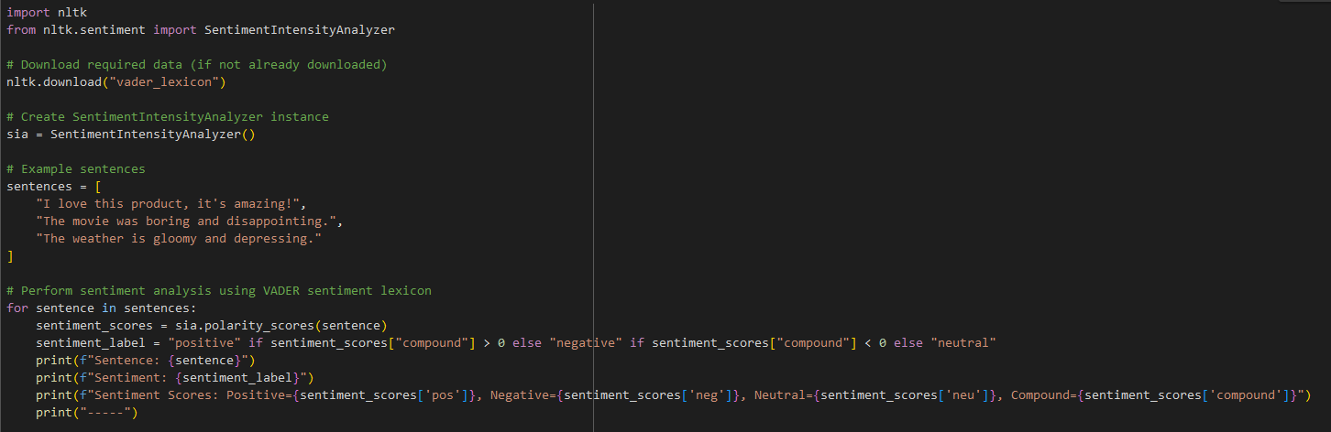
Examples of SL
VADER Example (Python Implementation)
We use the nltk library to perform sentiment analysis using the VADER sentiment lexicon.
We create a SentimentIntensityAnalyzer instance to analyze sentiment.
We provide example sentences for sentiment analysis.
The polarity_scores method computes sentiment scores for the given sentences, including positive, negative, neutral, and compound scores.
Based on the compound score, we classify the sentiment as positive, negative, or neutral.

Slide 12
Connotation Lexcions (CL)
Connotation lexicons are specialized resources that go beyond merely indicating positive, negative, or neutral sentiment associated with words.
They provide a more nuanced understanding of word meanings by capturing the emotional, associative, or cultural connotations that words carry.
These lexicons focus on the additional layers of meaning and associations that words evoke beyond their literal definitions.

Slide 13
Connotation Lexcions (CL)
Key Points
  Emotional and Associative Meanings
    Connotation lexicons delve into the emotional nuances, cultural associations, and implied meanings that words carry based on context and usage.
  Subjectivity
    Connotations are often subjective and can vary between different individuals, cultures, and contexts. Connotation lexicons attempt to capture these variations.
  Nuanced Sentiments
    While sentiment lexicons focus on simple positive/negative sentiment, connotation lexicons acknowledge that words can convey complex feelings, attitudes, and shades of meaning.
  Language Nuances
    Connotations are an essential part of language use and can influence how words are chosen to express ideas, evoke emotions, and create imagery.
  Applications
    Connotation lexicons find applications in creative writing, advertising, branding, rhetoric analysis, and any task that requires a deep understanding of the layers of meaning within language.

Slide 14
Examples of CL
ANEW (Affective Norms for English Words)
ANEW is a connotation lexicon that goes beyond sentiment analysis to capture a wide range of emotional and connotative dimensions associated with words.
It provides scores for multiple emotional dimensions, such as valence (positiveness/negativeness), arousal (intensity), and dominance (control or influence).
NRC Emotion Lexicon
The NRC Emotion Lexicon is a resource that assigns words emotional labels related to eight basic emotions, including anger, fear, anticipation, trust, surprise, sadness, joy, and disgust.
This lexicon provides a more granular understanding of how words evoke specific emotional reactions beyond simple positive/negative sentiment.

Slide 15
Examples of CL
ANEW (Affective Norms for English Words) Example:
  ANEW captures emotional dimensions beyond sentiment, such as valence, arousal, and dominance. Let's consider the word "bittersweet":
    Valence score: 4.46 (positive valence)
    Arousal score: 5.33 (moderately arousing)
    Dominance score: 4.11 (moderate dominance)
  The word "bittersweet" is associated with positive emotions but also carries an element of complexity and mixed emotions, as reflected by its arousal and dominance scores.
NRC Emotion Lexicon Example:
  The NRC Emotion Lexicon categorizes words into different emotions. Let's analyze the word "surprise":
    Emotion labels: Surprise (1), Joy (1), Sadness (0), Fear (0), Anger (0), Trust (0), Anticipation (0), Disgust (0)
  The word "surprise" is primarily associated with the emotion of surprise and, to a lesser extent, with joy.
  This indicates that the word evokes feelings of unexpectedness and excitement.

Slide 16
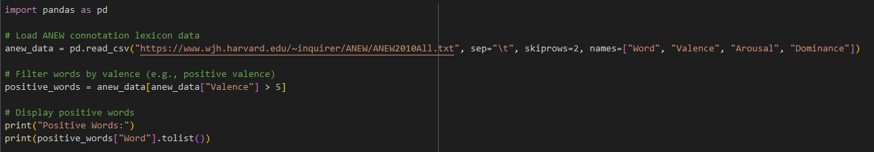
Examples of CL
ANEW Example (Python Implementation)
In this example:
We use the pandas library to handle data manipulation.
The ANEW connotation lexicon data is loaded from the URL using pd.read_csv(). It contains columns for words, valence, arousal, and dominance scores.
We filter the words based on valence, considering words with valence scores greater than 5 as positive.
We display the list of positive words.

Slide 17
Applications
Sentiment Analysis in Social Media
  Sentiment and connotation lexicons play a crucial role in analyzing social media content.
  Businesses and organizations use these resources to monitor public sentiment towards their products, services, and campaigns.
  By analyzing social media posts and comments, sentiment lexicons help gauge how customers perceive brands and products, identify customer concerns, and track shifts in public opinion over time.
Brand Sentiment Monitoring
  Sentiment and connotation lexicons enable companies to track the sentiment associated with their brand and competitors in the market.
  By analyzing reviews, feedback, and customer conversations, businesses can gain insights into customer opinions, identify areas for improvement, and make data-driven decisions to enhance their brand perception.
Creative Writing and Content Creation
  Connotation lexicons are valuable tools for writers, content creators, and marketers.
  When crafting content, writers can use connotation lexicons to select words that evoke specific emotions or nuances, enhancing the impact and engagement of their writing.
  Creative professionals can ensure that the intended tone and emotional resonance are conveyed effectively in their work.

Slide 18
Applications
Movie and Music Reviews
  Sentiment and connotation lexicons find application in analyzing movie and music reviews.
  Critics and audiences alike can use these resources to assess the emotional and connotative dimensions of a film or song.
  By understanding how certain words are perceived, reviewers can better convey their opinions about the artistic work.
Advertising and Marketing Campaigns
  Advertisers and marketers use sentiment and connotation lexicons to gauge how their marketing campaigns are received by the target audience.
  By analyzing customer feedback, comments, and interactions with advertisements, marketers can adjust their campaigns to align with the desired emotional and associative responses.
Psychological and Clinical Analysis
  Sentiment and connotation lexicons find application in psychological and clinical analysis.
  Researchers and practitioners can analyze written content, such as patient testimonials or diary entries, to gain insights into emotional states, track mood changes, and provide more personalized interventions.

Slide 19
Combine with Machine Learning
Lexicon-Based Methods
  Lexicon-based sentiment analysis involves assigning sentiment scores to text based on the presence of words from sentiment or connotation lexicons.
  Each word in the text is matched against the lexicon, and its associated sentiment value contributes to the overall sentiment of the text.
  The sentiment score can be calculated by summing or averaging the individual word scores.
  This approach is straightforward and can provide a quick sentiment estimate.
Hybrid Approaches
  Hybrid approaches combine lexicon-based methods with machine learning techniques to enhance sentiment analysis.
  In this setup, sentiment lexicons are used as additional features alongside other linguistic or contextual features in machine learning classifiers.
  The machine learning model learns to weigh the importance of various features, including lexicon-based features, in predicting sentiment.
  This approach leverages the strengths of both lexicons and machine learning algorithms.

Slide 20
Combine with Machine Learning
Example in a hybrid approach for sentiment analysis
  Feature Extraction: Lexicon-based features are extracted by calculating sentiment scores for words in the text using a sentiment lexicon.
  Additional Features: Other features, such as word embeddings, syntactic features, and contextual information, are also extracted from the text.
  Training the Classifier: A machine learning classifier, such as a support vector machine (SVM) or a neural network, is trained on a labeled dataset. The lexicon-based features, along with other features, are used as input to the classifier.
  Weighted Contributions: During training, the classifier learns how to weight the contributions of different features, including the sentiment lexicon-based features, to make accurate sentiment predictions.
  Inference: When applied to new text, the trained classifier considers both lexicon-based features and other features to predict the sentiment.

Slide 21
Practice
Instructions
  In this assignment, you'll explore lexicons for sentiment effect and connotation analysis using Python.
Tasks
  Task 1: Exploring Sentiment Effect Lexicons
    Choose a sentiment effect lexicon (e.g., AFINN, EmoLex) or create a simple one.
    Load the lexicon data (either from a file or manually).
    Implement a function to calculate the overall sentiment effect score for a given text, considering the scores of individual words.
  Task 2: Exploring Connotation Lexicons
    Choose a connotation lexicon (e.g., ANEW, LIWC) or create a simple one.
    Load the lexicon data (either from a file or manually).
    Implement a function to analyze the emotional connotations of words in a given text using the lexicon data.

Slide 22
Q & A

